Slide 1
Melbourne Property analysis
Ali Yazdan
Asal Valisoltani
Ray Jong
Kylie Collins

Slide 2
aGENDA
INTRODUCTION
Ali
CLEANING DATA
Asal
VISUALISATIONS
Ray and Kylie
FINDINGS, CONCLUSIONS
Ali
Notes:
2.5 MINUTES EACH

Slide 3
iNTRODUCTION
Lottery winner won $1 million to buy large family home
Budget $800k - $1m
Family of 4: husband and 2 children
Works in CBD
Free standing home, 4 BR, 2 garage, large.
Compare different Victorian regions re price, distance to CBD, schools, shopping, transport
Purpose: to use data to inform her investment decision
Notes:
A Lottery winner, in her 40s, has won $1M and would like to invest it in her dream family home. She has 2 teenage children, a daughter and a son, who enjoy their own privacy and would love to have a place big enough to invite friends over. Both herself and her husband work in the Melbourne CBD and they own 1 car. Considering that this $1M will be her only substantial income enough to make her dream home come true, she has decided to approach our Buyer’s Advocate firm in order to make the most informed decision for herself and her family. The client has also expressed her preference that if she would be able to find the perfect home below $1M, it would help her to upgrade her car and to buy a second one.

Slide 4
Cleaning data

Slide 5
VISUALISATIONS

Slide 6
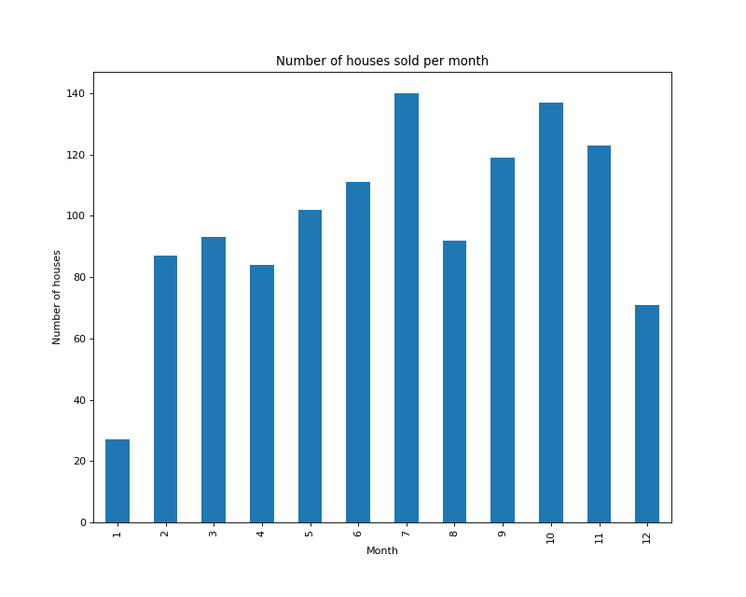

Slide 7
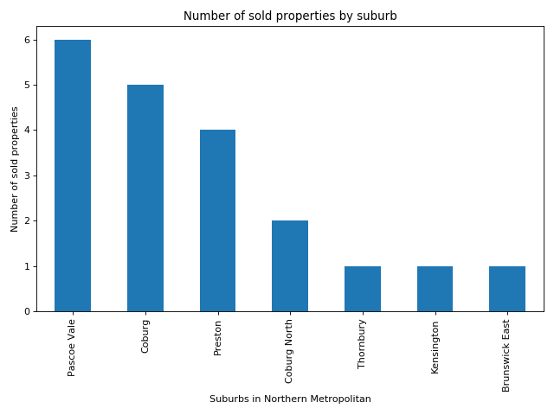

Slide 8
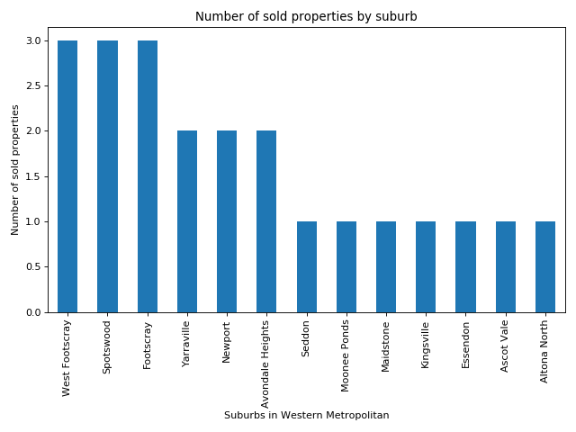

Slide 9
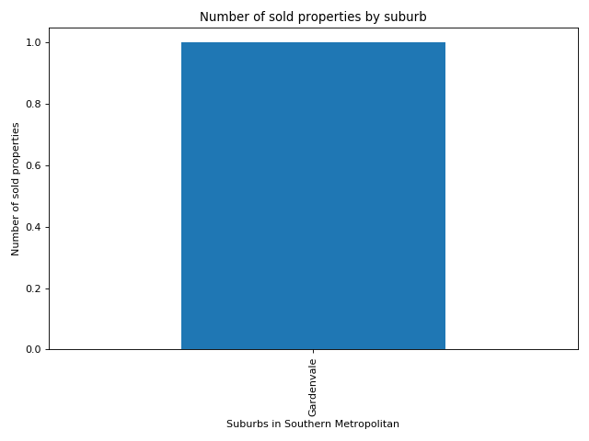

Slide 10
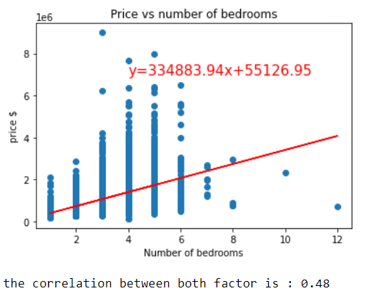

Slide 11
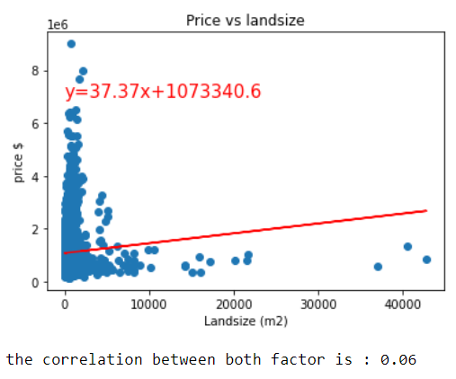

Slide 12
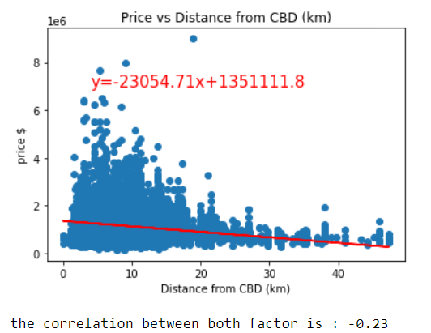

Slide 14
Land size vs distance from cbd

Slide 15
Median age per region

Slide 16
Median bedrooms per region

Slide 17
Proportion of regions with properties sold $800k-$1m

Slide 18
PLOTTING THE MAPS
Using Geoapify we wanted to look at 3x of amenities to help determine the best location to purchase a property:
Schools
Shopping Centre's
Transport
The foundation code created was to bring back the below details with a filter of av 15km radius from Melbourne CBD.
Facility Name
Facility Address
Facility Postcode
Distance to the CBD
Latitude and Longitude

Slide 19
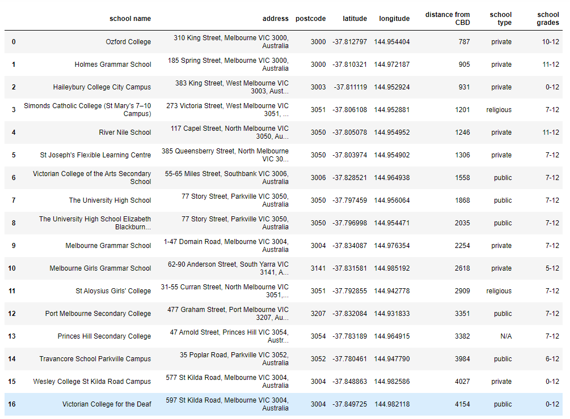
School map
Additional filters in place for schools:
School Type – I wanted to show all options, e.g. public, private, as this may also be taken into consideration for the buyer.
School Grades - with a further filter to remove schools that only cater up to year 6.
Once the school grades filter was performed, we had a smaller, more precise list of options

Slide 20
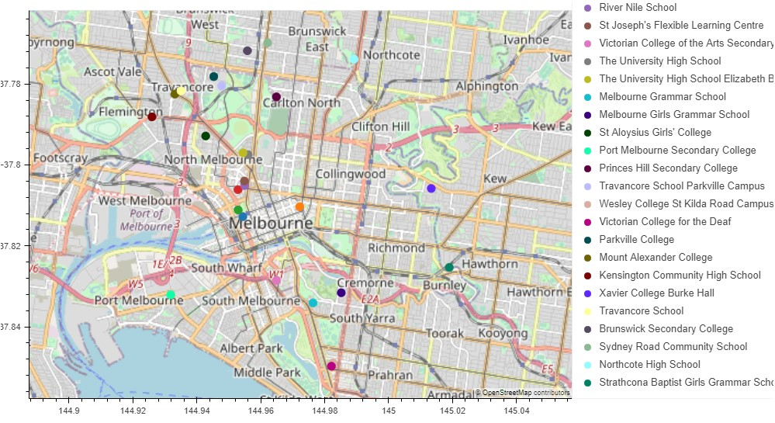
School map

Slide 21
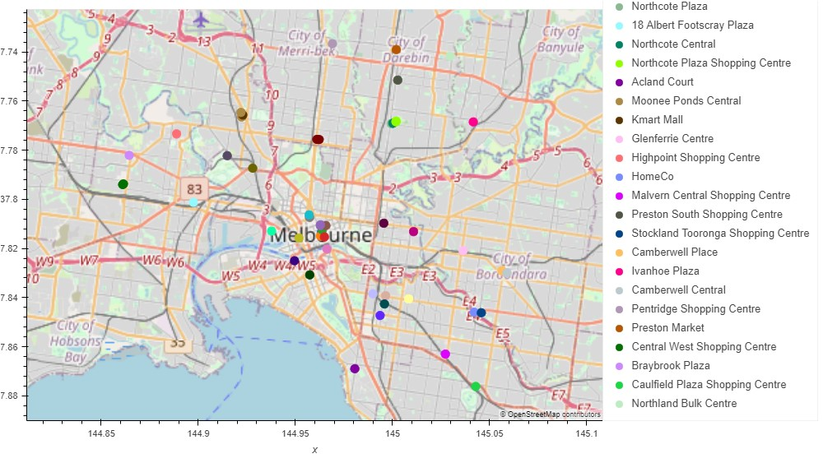
SHOPPING map

Slide 22
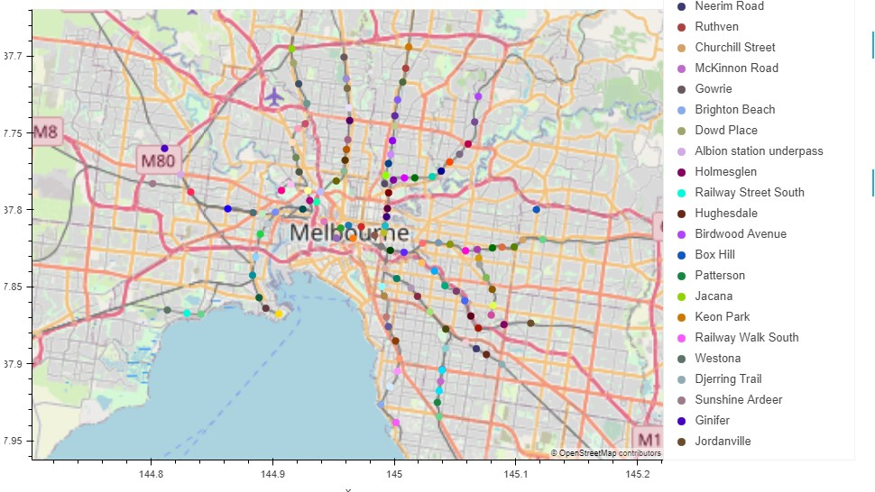
TRANSPORT map

Slide 23
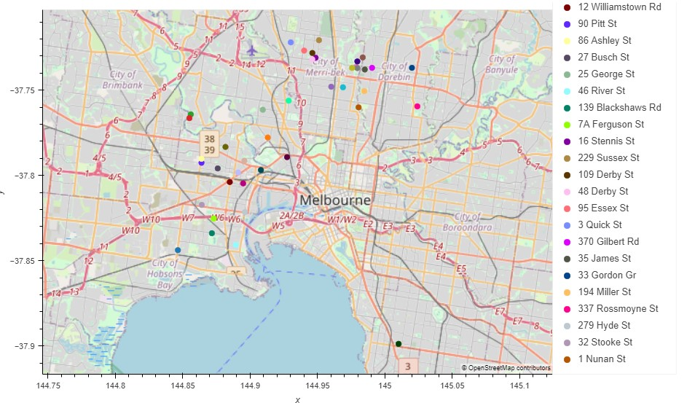
HOUSING SALE map
Using the sales data csv file, I generated a map plotting the location of where these sales happened.
From this new DataFrame, I copied only the columns that might be useful for the plotting:
Address
Suburb
Postcode
Rooms
Bathrooms
Carparks
Latitude
Longitude
Price
Type
Distance
I then filtered the data so that only those sales that met below criteria set by the lottery winner:
Distance from CBD 10km
Number of Bedrooms 4
Number of Bathrooms 2
Number of carparks – more than 1

Slide 24
Findings, conclusions

